Slide 1
C#.NET Programming

Slide 2
Objectives
Explain about input/output in C#
Create C# Console Application using Visual Studio.NET
Describe more new features of C# :
var and dynamic type
ref, out and params
Local Function and Static Local Function
String Interpolation
Null-Condition Operator
Ref locals and Ref returns
Discards and Pattern Matching
Numeric literal syntax
Tuples

Slide 3
Introduction to C#
C# is an object-oriented, component-oriented programming language
C# provides language constructs to directly support these concepts, making C# a natural language in which to create and use software components
Several C# features help create robust and durable applications:
Garbage collection automatically reclaims memory occupied by unreachable unused objects
Exception handling provides a structured and extensible approach to error detection and recovery
Lambda expressions support functional programming techniques. Language Integrated Query (LINQ) syntax creates a common pattern for working with data from any source. Language support for asynchronous operations provides syntax for building distributed systems and so on

Slide 4
Demo Create C# Console App using Visual Studio.NET

Slide 5
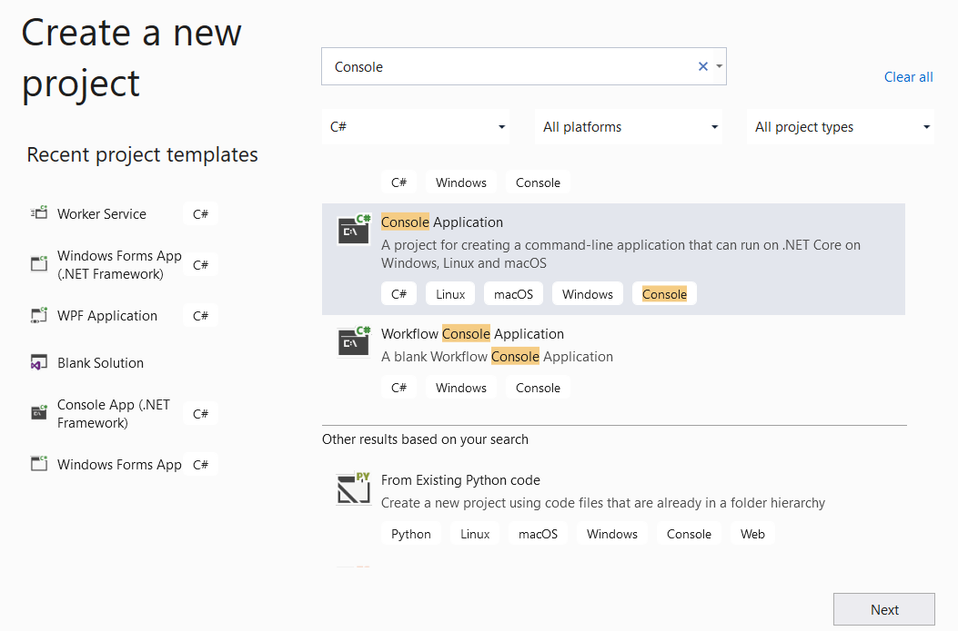
1. Open Visual Studio.NET , File | New | Project
1
2
3

Slide 6
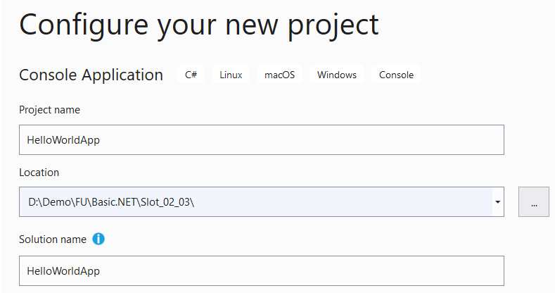

2. Fill out Project name: HelloWorldApp and Location then click Next
4
5
6

Slide 7
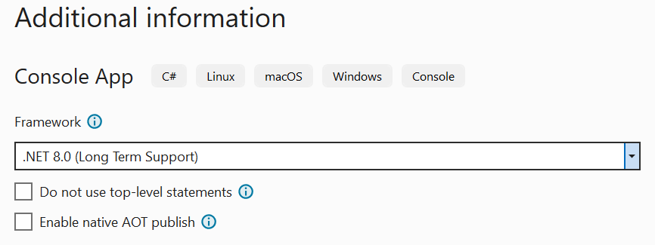

3. Choose Target Framework: .NET 8.0 (Long Term Support) then click Create
7
8

Slide 8
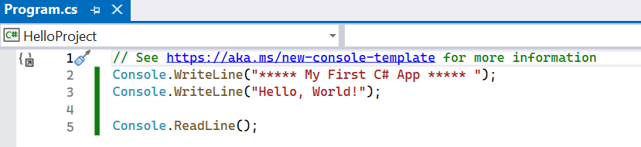
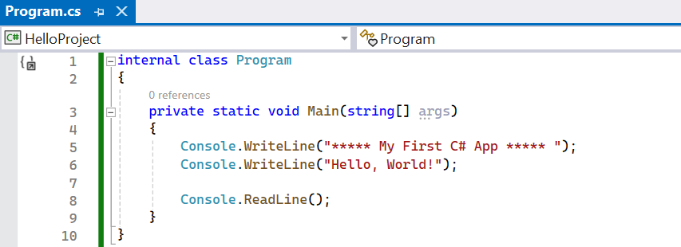
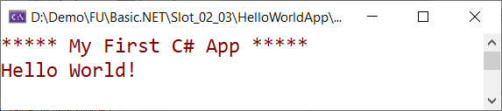
4. Write code for Main method then press F5(run Debugging) or Ctrl+F5(run without Debugging) to run application

Slide 9
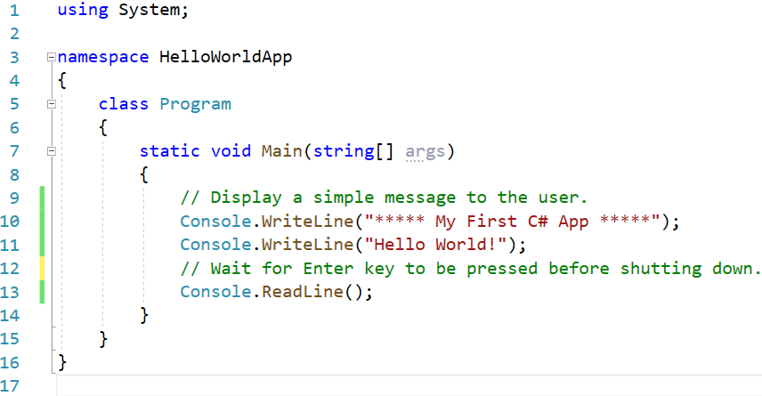
Structure of a C# program
Referencing namespace
Namespace of the current class
Entry point: Main()

Slide 10
Namespaces in C#
Namespaces are used to organize the classes. It helps to control the scope of methods and classes in larger .Net programming projects
The biggest advantage of using namespace is that the class names which are declared in one namespace will not clash with the same class names declared in another namespace. It is also referred as named group of classes having common features
The members of a namespace can be namespaces, interfaces, structures, and delegates.

Slide 11
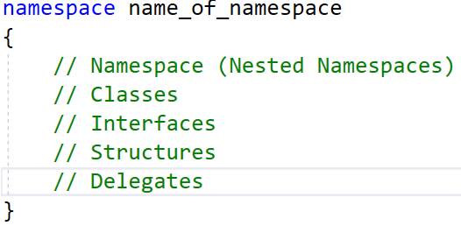
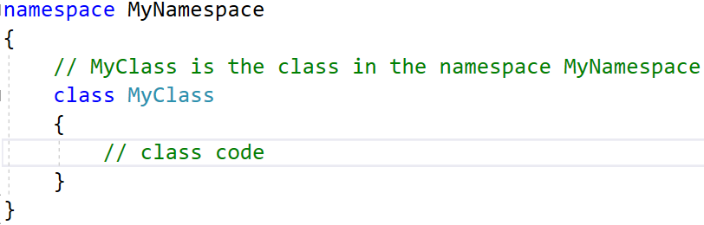
Namespaces in C#
To define a namespace in C#, we will use the namespace keyword followed by the name of the namespace and curly braces containing the body of the namespace as follows:

Slide 12
Namespaces in C#
For console applications, .NET 8 the following directives are implicitly included in the application:
using System;
using System.IO;
using System.Collections.Generic;
using System.Linq;
using System.Net.Http;
using System.Threading;
using System.Threading.Tasks;

Slide 13
Variations on the Main() Method
By default, Visual Studio will generate a Main() method that has a void return value and an array of string types as the single input parameter
To construct application’s entry point using any of the following signatures:
static int Main(string[] args){
// Must return a value before exiting!
return 0;
}
// No return type, no parameters.
static void Main(){
}
// int return type, no parameters.
static int Main(){
// Must return a value before exiting!
return 0;
}
The Main() method can be asynchronous
static Task Main()
static Task<int> Main()
static Task Main(string[])
static Task<int> Main(string[])

Slide 14
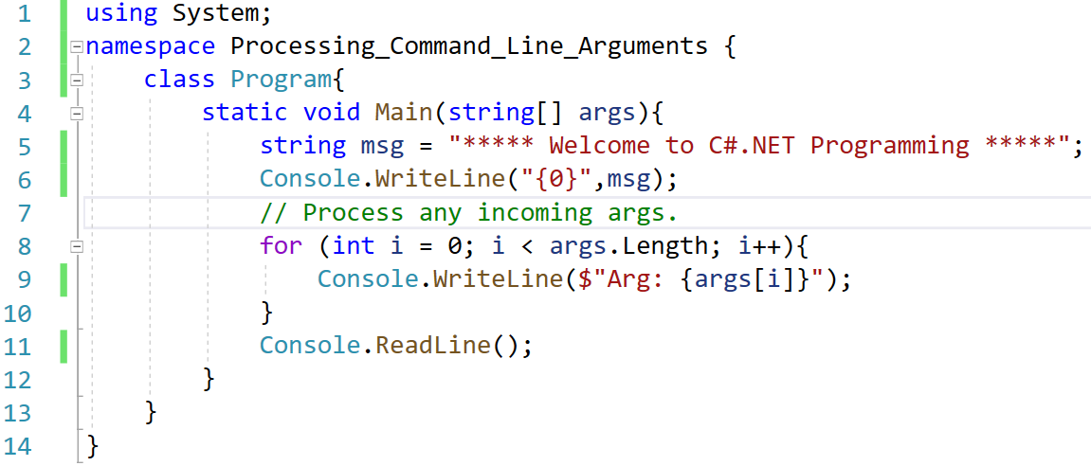
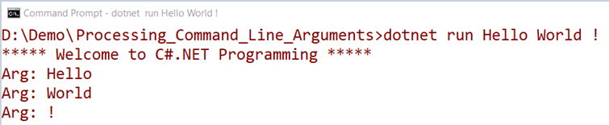
Processing Command-Line Arguments
Create C# Console App as the following and run it by dotnet CLI

Slide 15
Value Types and Reference types
Value types derive from System.ValueType, which derives from System.Object. Types that derive from System.ValueType have special behavior in the CLR(Common Language Runtime).
There are two categories of value types: struct and enum
Reference type: A type that is defined as a class, delegate, array, or interface is a reference type.
At run time, when declare a variable of a reference type, the variable contains the value null until you explicitly create an object by using the new operator, or assign it an object that has been created elsewhere by using new

Slide 16
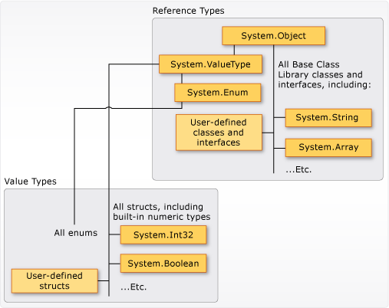
Value Types and Reference types

Slide 17
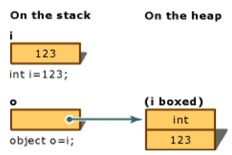
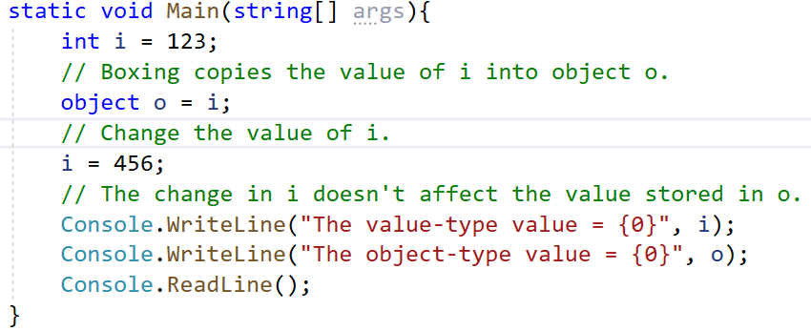

Boxing and Unboxing
Boxing is the process of converting a value type to the type object or to any interface type implemented by this value type. When the common language runtime (CLR) boxes a value type, it wraps the value inside a System.Object instance and stores it on the managed heap

Slide 18
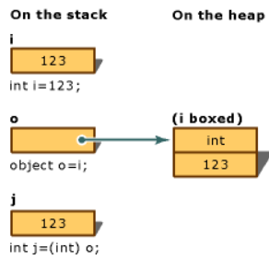
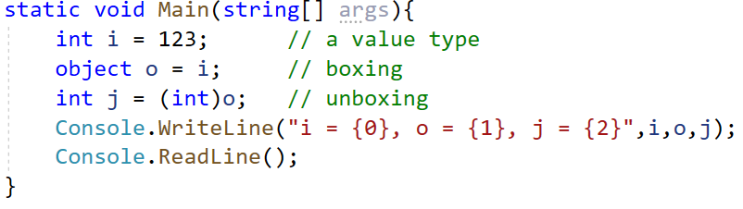

Boxing and Unboxing
Unboxing is an explicit conversion from the type object to a value type or from an interface type to a value type that implements the interface
An unboxing operation consists of: Checking the object instance to make sure that it is a boxed value of the given value type and Copying the value from the instance into the value-type variable
If we change code line:
int j = (int)o to int j = (short)o
what happens?

Slide 19
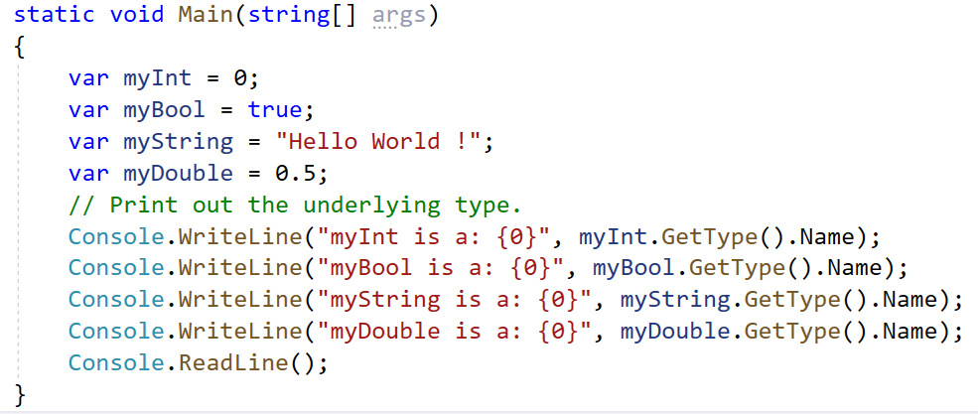
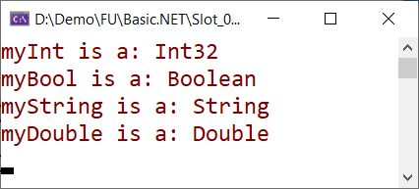
var keyword
The var keyword can be used in place of specifying a specific data type (such as int, bool, or string) and the compiler will automatically infer the underlying data type based on the initial value used to initialize the local data point.

Slide 20
var keyword
The following restrictions apply to implicitly-typed variable declarations:
var can only be used when a local variable is declared and initialized in the same statement; the variable cannot be initialized to null, or to a method group or an anonymous function
var cannot be used on fields at class scope
Variables declared by using var cannot be used in the initialization expression
Multiple implicitly-typed variables cannot be initialized in the same statement

Slide 21
dynamic type
The dynamic type is a static type, the compiler does not check the type of the dynamic type variable at compile time, instead of this, the compiler gets the type at the run time
In most of the cases, the dynamic type behaves like object types
The dynamic type changes its type at the run time based on the value present on the right-hand side
To get the actual type of the dynamic variable at runtime by using GetType() method
Can pass a dynamic type parameter in the method so that the method can accept any type of parameter at run time

Slide 22
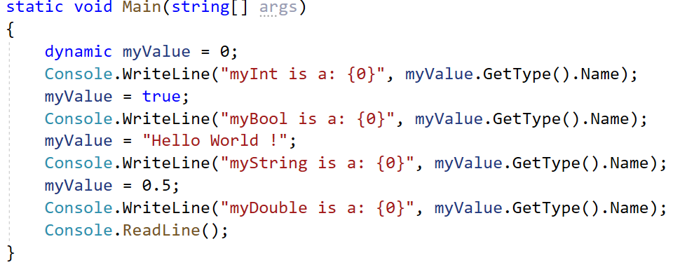
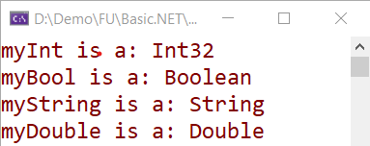
dynamic type

Slide 23
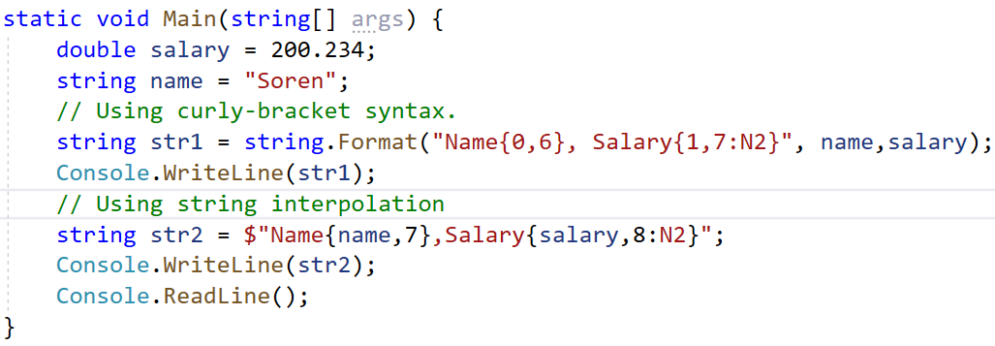

String Interpolation
The string interpolation feature is built on top of the composite formatting feature and provides a more readable and convenient syntax to include formatted expression results in a result string.
To identify a string literal as an interpolated string, prepend it with the $ symbol
$ " <text> { <interpolation-expression> <optional-comma-field-width> <optional-colon-format> } <text> {... } "

Slide 24
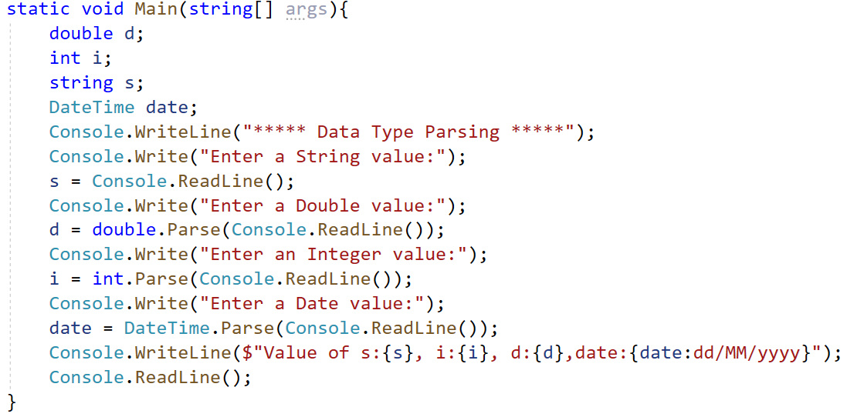
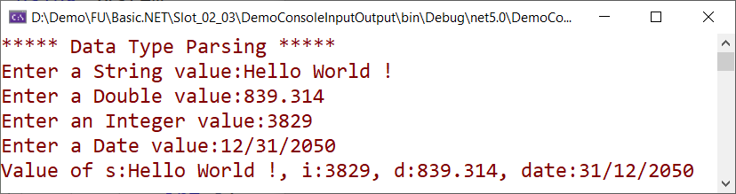
The Console Class
The Console type defines a set of methods to capture input and output, all of which are static, therefore, called by prefixing the name of the class Console to the method name

Slide 25
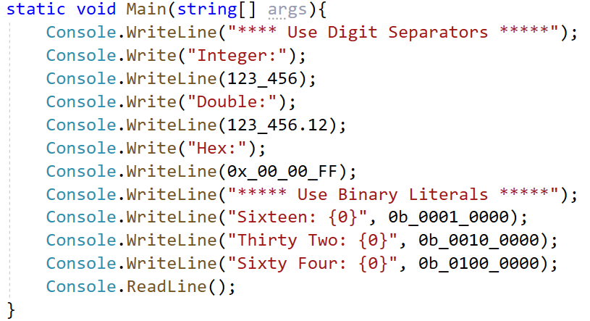
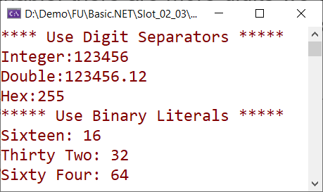
Numeric Literal Syntax
When assigning large numbers to a numeric variable, there are more digits we can use underscore (_) as a digit separator (for integer, long, decimal, double data, or hex types)
C# provides also a new literal for binary values allows for binary numbers to start with an underscore

Slide 26
Passing Parameters with ref, out and params
In C#, arguments can be passed to parameters either by value or by reference.
Passing by reference enables function members, methods, properties, indexers, operators, and constructors to change the value of the parameters and have that change persist in the calling environment
To pass a parameter by reference with the intent of changing the value, use the ref, or out keyword
The ref keyword makes the formal parameter an alias for the argument, which must be a variable
An argument that is passed to a ref parameter must be initialized before it is passed

Slide 27
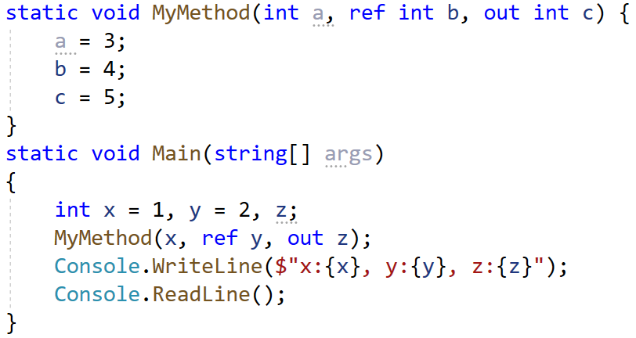
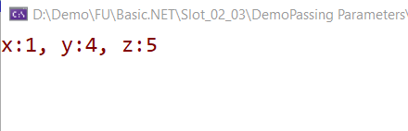
Passing Parameters with ref, out and params
Variables passed as out arguments do not have to be initialized before being passed in a method call. However, the called method is required to assign a value before the method returns

Slide 28
Passing Parameters with ref, out and params
The params keyword allows you to pass into a method a variable number of identically typed parameters (or classes related by inheritance) as a single logical parameter
The arguments marked with the params keyword can be processed if the caller sends in a strongly typed array or a comma-delimited list of items
The parameter type must be a single-dimensional array
No additional parameters are permitted after the params keyword in a method declaration, and only one params keyword is permitted in a method declaration

Slide 29
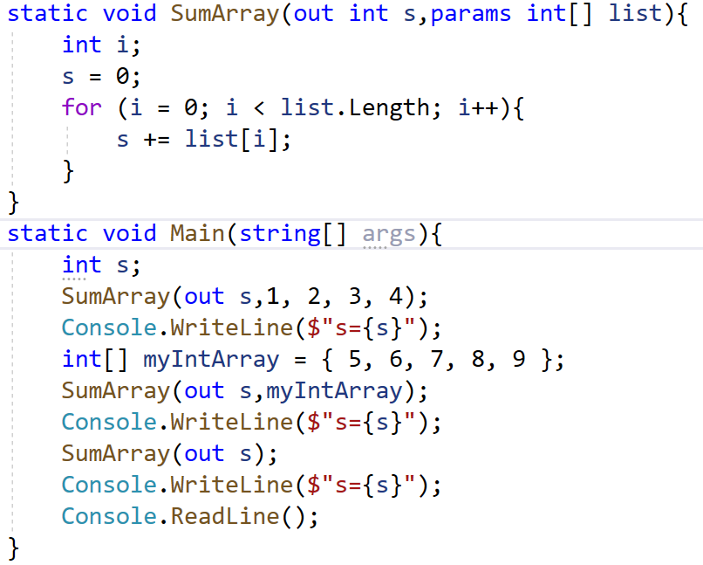
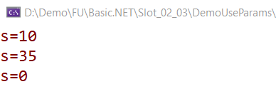
Passing Parameters with ref, out and params

Slide 30
Ref locals and Ref returns
A reference return value(ref returns) allows a method to return a reference to a variable, rather than a value, back to a caller. The caller can then choose to treat the returned variable as if it were returned by value or by reference. The caller can create a new variable that is itself a reference to the returned value, called a ref local.
A method that returns a reference return value must satisfy the following two conditions:
The method signature includes the ref keyword in front of the return type
Each return statement in the method body includes the ref keyword in front of the name of the returned instance

Slide 31
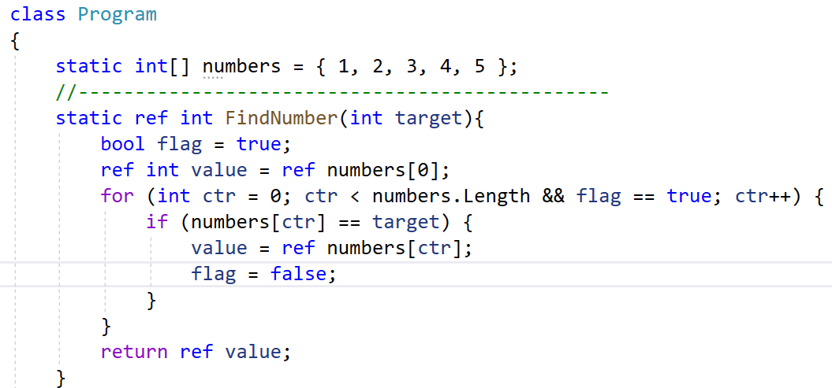
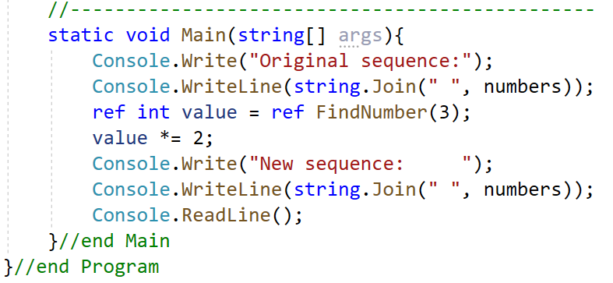
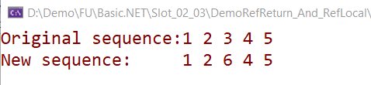
Ref locals and Ref returns

Slide 32
Local Function and Static Local Function
The local function allows declaring a method inside the body of an already defined method. Or in other words, we can say that a local function is a private function of a function whose scope is limited to that function in which it is created
The type of local function is similar to the type of function in which it is defined. We can only call the local function from their container members
Local functions can be defined anywhere inside a method: the top, the bottom, or middle
Local function can access the local variables that are defined inside the container method including method parameters

Slide 33
Local Function and Static Local Function
Local function allows to pass out/ref parameters, using generic and using params keyword
Cannot declare a local function in the expression-bodied member
Not allowed to use any member access modifiers in the local function definition, including private keyword because they are by default private
Overloading is not allowed for local functions
Using the static modifier to declare a local function as a static local function, ensure the local function doesn’t reference any variables from the enclosing scope

Slide 34
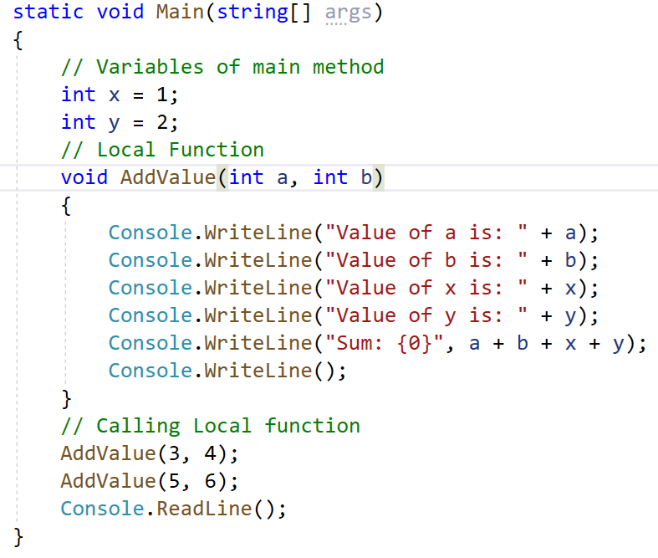
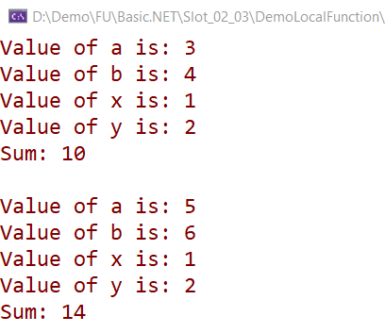
Local Function and Static Local Function

Slide 35
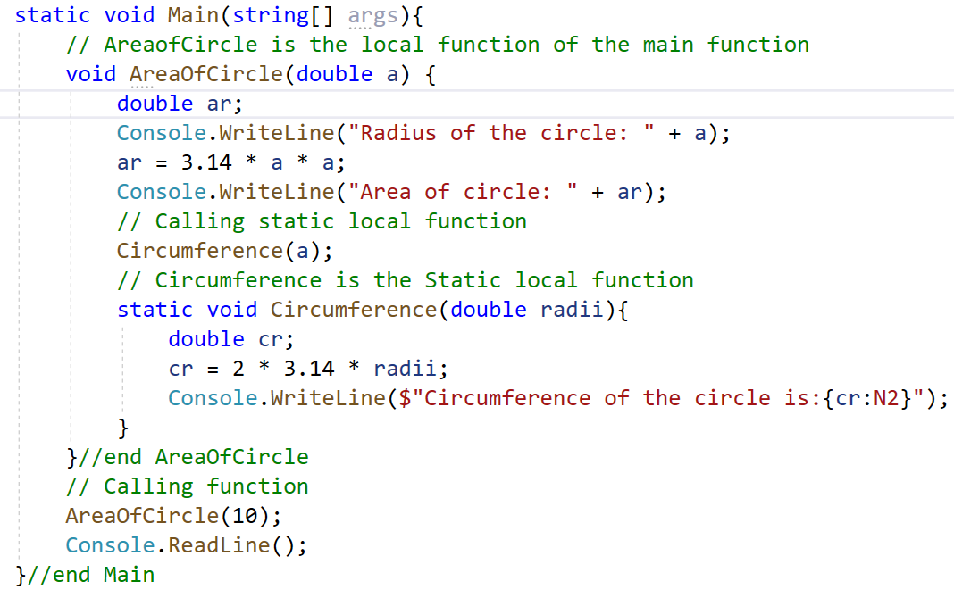
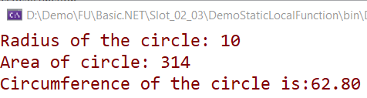
Local Function and Static Local Function

Slide 36
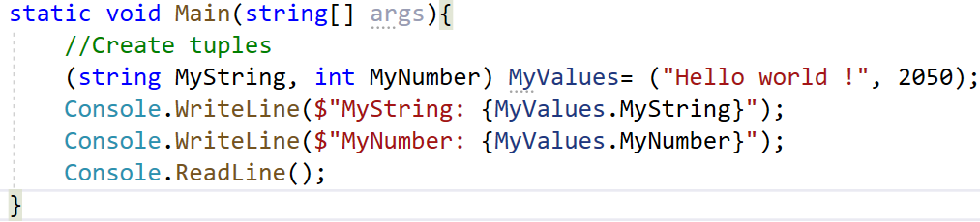

Tuples
The tuples feature provides concise syntax to group multiple data elements in a lightweight data structure which gives us the easiest way to represent a data set that has multiple values that may/may not be related to each other
Each property in a tuple can be assigned a specific name (just like variables), greatly enhancing the usability
There are two important considerations for tuples: the fields are not validated and cannot define our methods

Slide 37
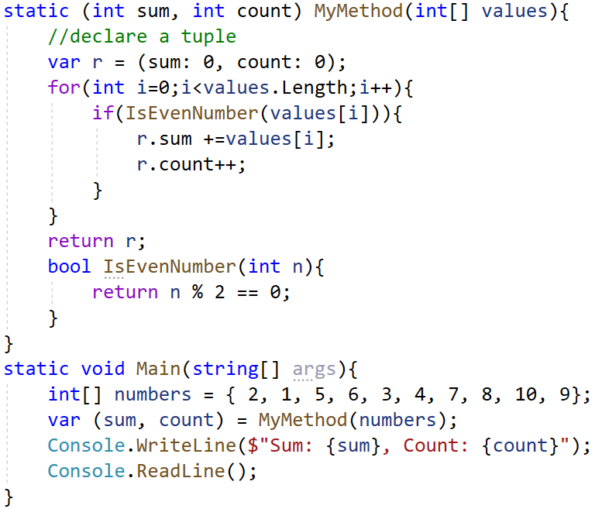

Tuples

Slide 38
Discards
C# allows discard the returned value which is not required. Underscore (_) character is used for discarding the parameter
Discards are equivalent to unassigned variables, they don't have a value.
Discards can reduce memory allocations.
Discards make the intent of our code clear. They enhance its readability and maintainability.

Slide 39
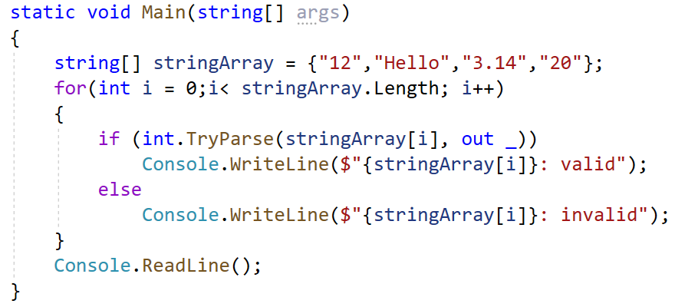
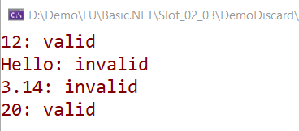
Discards
Using discard with out parameter

Slide 40
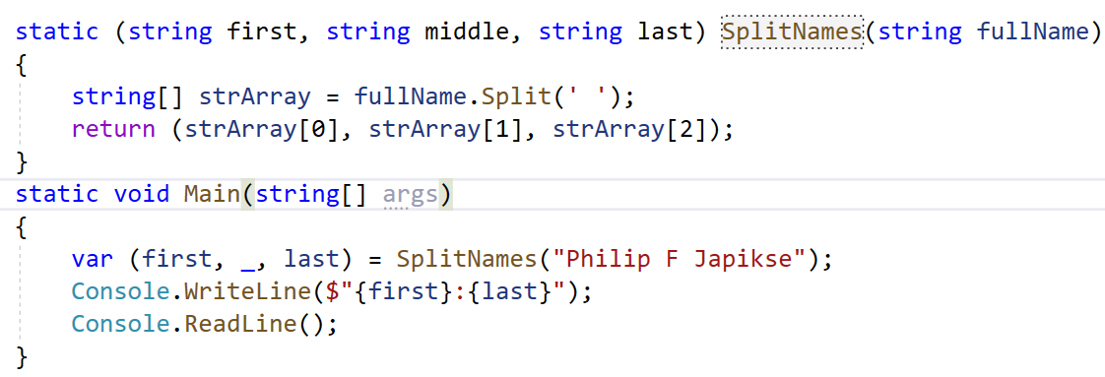

Discards
Using discard with Tuples

Slide 41
Pattern Matching
Pattern matching allows the developer to match a value (or an object) against some patterns to select a branch/block of the code through the use of is patterns and case patterns
The is pattern
The is pattern allows we to check whether an input variable is of a certain type, and then assign it to a new variable named count.
if (input is int count && count > 0)
This pattern can also be used to check if an input variable is null:
if (input is null)

Slide 42
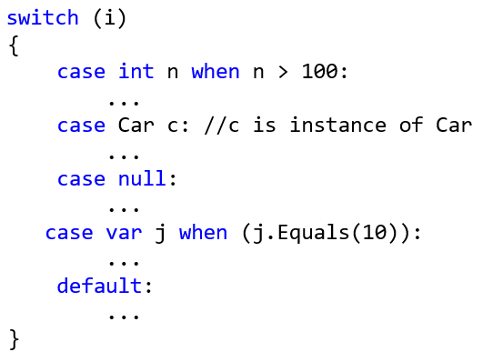
Pattern Matching
The case pattern
The switch statement cases also support patterns. These patterns can include a type check, plus additional conditions:

Slide 43
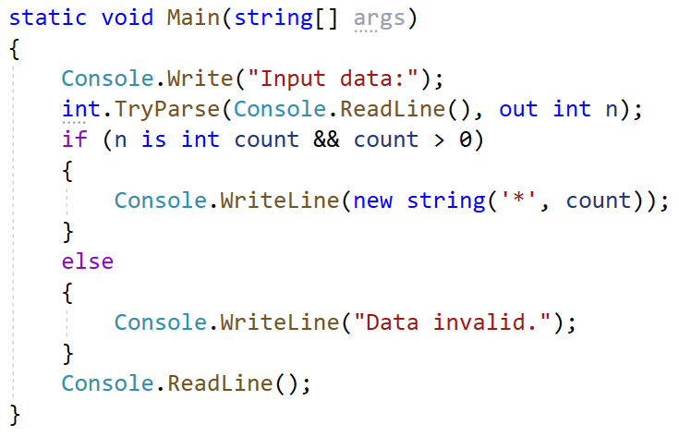
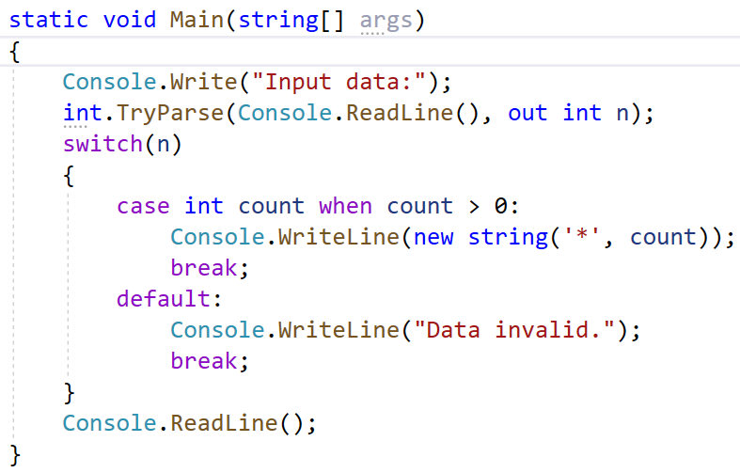
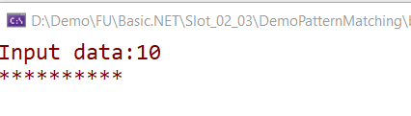
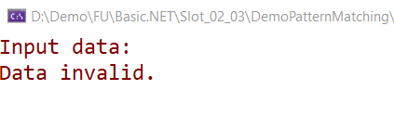
Pattern Matching

Slide 44
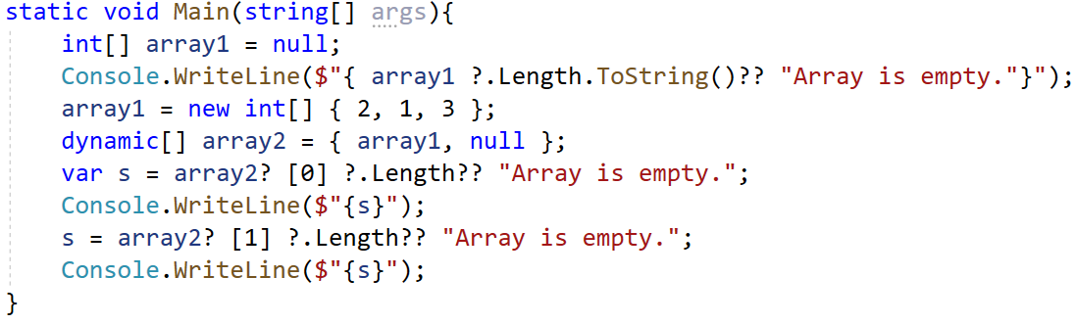
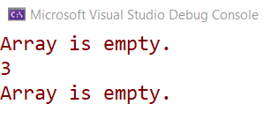
Null-Condition Operator
Used to test for null before performing a member access (?.) or index (?[]) operation. These operators help we write less code to handle null checks
If a evaluates to null, the result of a?.x or a?[x] is null.
If a evaluates to non-null, the result of a?.x or a?[x] is the same as the result of a.x or a[x], respectively.

Slide 45
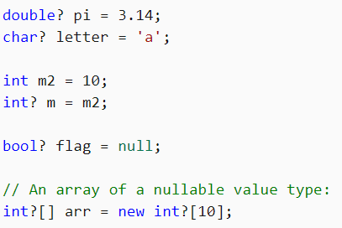
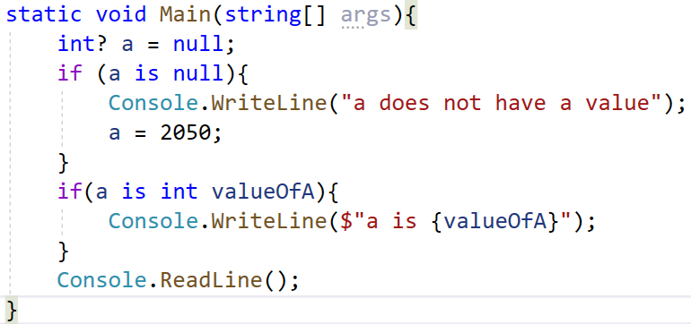

Nullable value types
A nullable value type T? represents all values of its underlying value type T and an additional null value

Slide 46


Nullable reference types
Nullable reference types follow many of the same rules as nullable value types. Nullable reference types can be null, but still must be assigned something before first use
Nullable reference types use the same symbol (?) to indicate that they are nullable

Slide 47

Primary Constructors for Classes and Structs
Define constructors directly within the class or struct declaration for concise syntax.
Usage:
Person person = new("John", "Doe");

Slide 48

Alias Any Type
Create aliases for any type, including unnamed types like tuples, for improved readability and conciseness.

Slide 49
Summary
Explain about input/output in C#
Demo create C# Console Application using Visual Studio.NET
Describe more new features of C# :
var and dynamic type
ref, out and params
Local Function and Static Local Function
String Interpolation and Namespaces
Null-Condition Operator and Nullable reference types
Ref locals and Ref returns
Discards and Pattern Matching
Numeric literal syntax
Tuples
Primary Constructors for Classes and Structs

